Slide 1










DATA SCIENCE
WITH
PYTHON
VANY VARHA VAUZIA

Slide 2




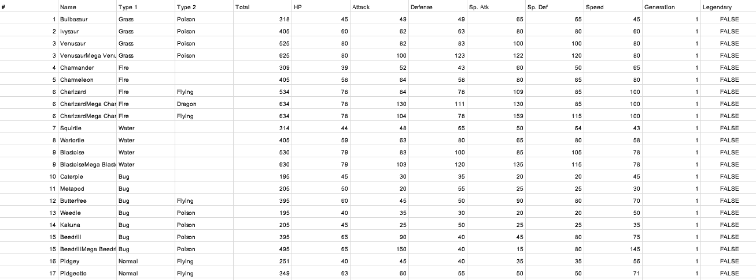


DATASET
The dataset used contains data on the number and type of powers possessed by characters from the Pokemon game designed and directed by Satoshi Tajiri from Japan

Slide 3

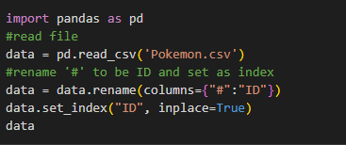
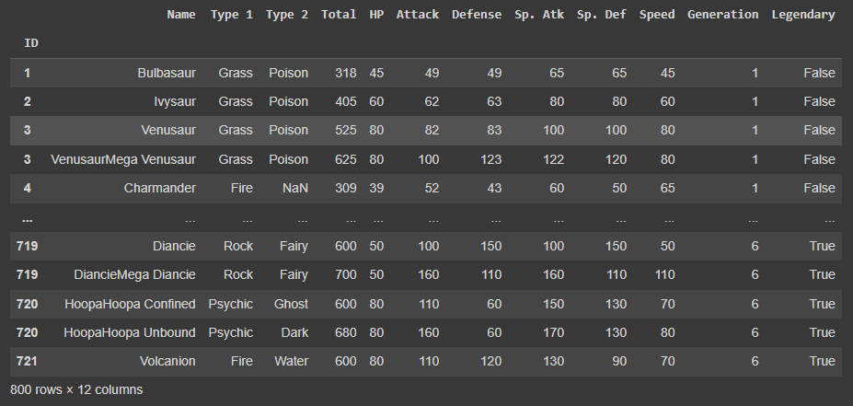

LOAD DATA
save and read data in dataframe then change the column name '#' to ID

Slide 4
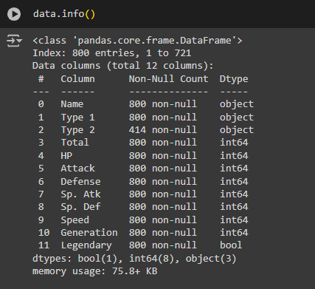
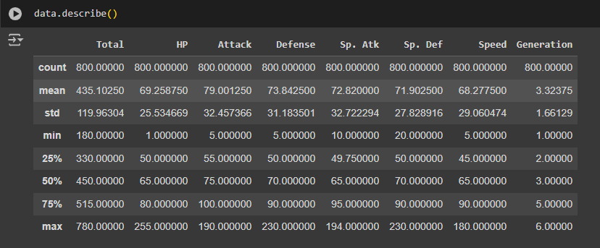
INFO DATA
The dataset has 800 rows and 12 columns, 3 objects, 8 integers and 1 boolean, but there are rows that are not filled.
DESCRIBE DATA
an overview of the different descriptive statistics in each numeric column

Slide 5
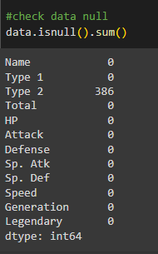

HANDLING MISSING VALUES
In general, NaN values ​​will be filled with average/median/mode values ​​as a technique used in numerical data to avoid information loss.
In this context, NaN values ​​are found in the category data of the uniqueness of the original Pokemon character, so it is not appropriate to fill it with a value.

Slide 6


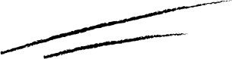
How many legendary characters are there in total for each generation?

Slide 7
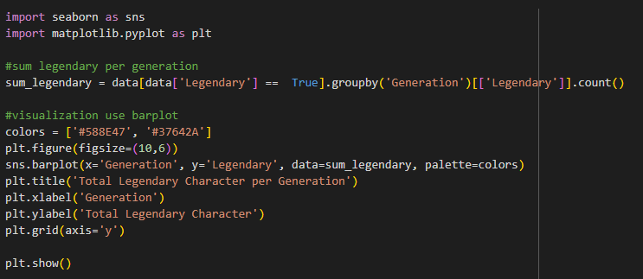
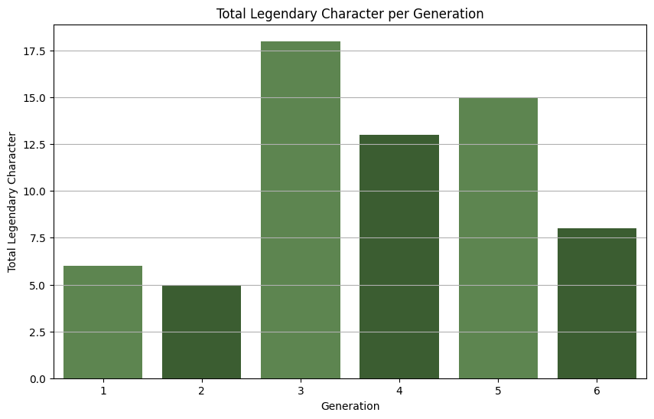

TOTAL LEGENDARY EACH GENEARTION
From Generation 1 to 6, the most legendary characters ever released by Game Freak were in generation 3, with 18 characters.

Slide 8


Who are the 5 strongest legendary characters from the 6 generations?

Slide 9

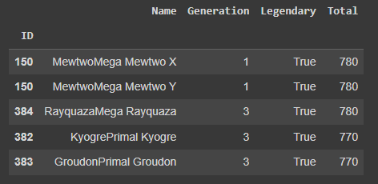
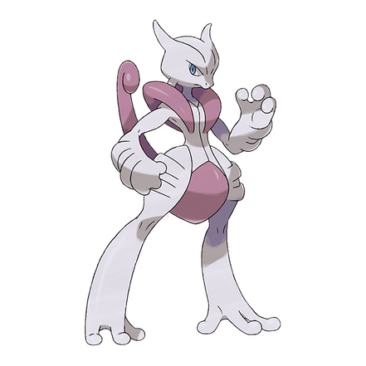
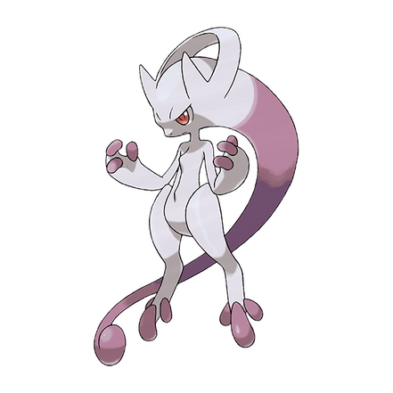
FIVE STRONGEST LEGEND
There are 3 legendary characters that have a score of 780, however their strength, speed and defense will not be the same.
Mega Mewtwo X
Mega Mewtwo Y

Slide 10


Who are the 5 strongest NON legendary characters from the 6 generations?

Slide 11
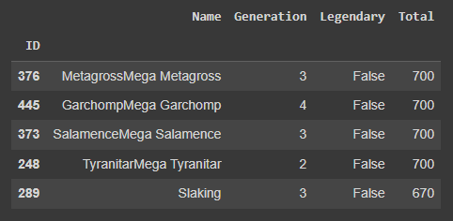
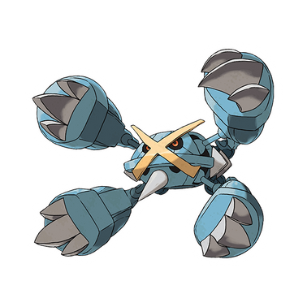
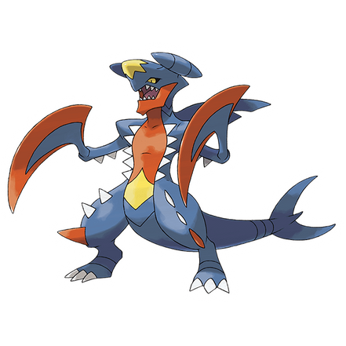
FIVE STRONGEST NON-LEGEND
There are 4 non-legendary characters that have a score of 700, however their strength, speed and defense will not be the same.
Mega Metagross
Mega Garchomp

Slide 12


Does the highest score determine a character as a legend?

Slide 13
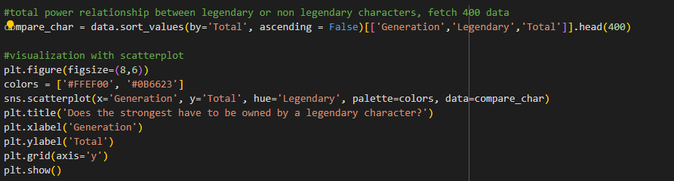
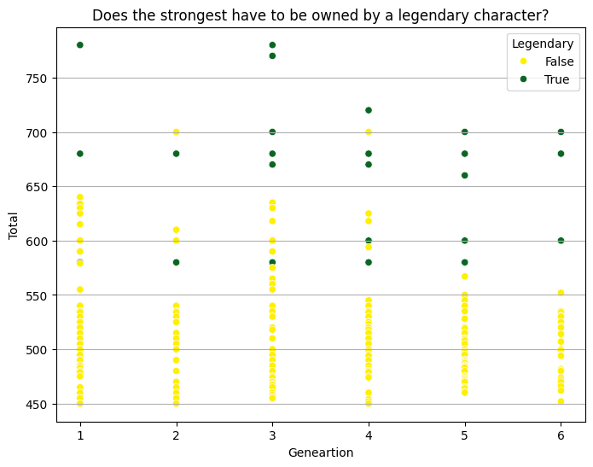
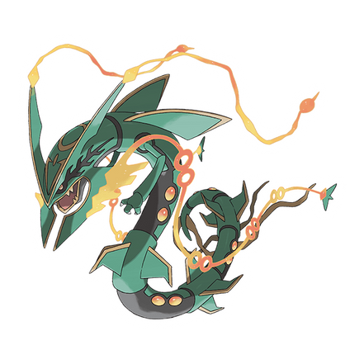
THE ANSWER IS NO
It's not just about strength statistics, there are many factors that determine whether a character is called a legendary character, one of which is the background and mythical story behind the birth of the character, or the rarity or uniqueness of a character.
Mega Rayquaza
True = Legend Character
False = Non-Legend Character

Slide 14
Is a character that has 2 types always superior?

Slide 15
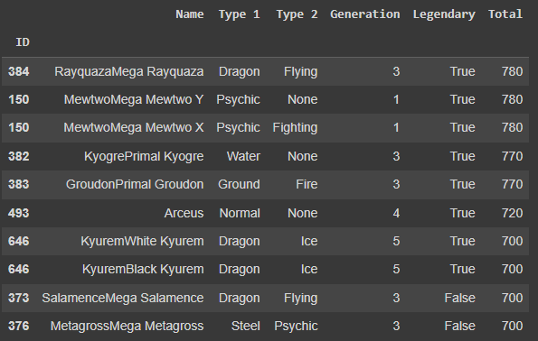

THE ANSWER IS NO
Pokemon characters that have 2 types do not always have the upper hand in battle, there are several factors such as the type of opponent they face which can be a weakness or the opponent's high statistics even though they only have 1 type.
Kyogre Primal

Slide 16


who are the five best characters in speed, attack and defense?

Slide 17

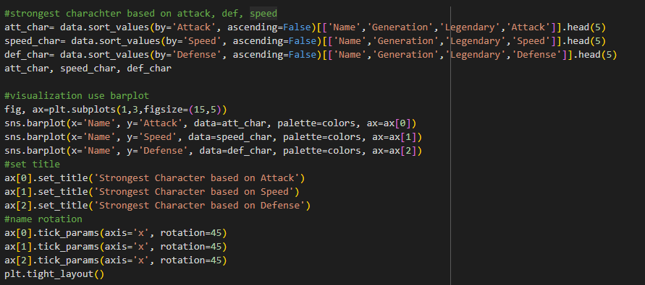

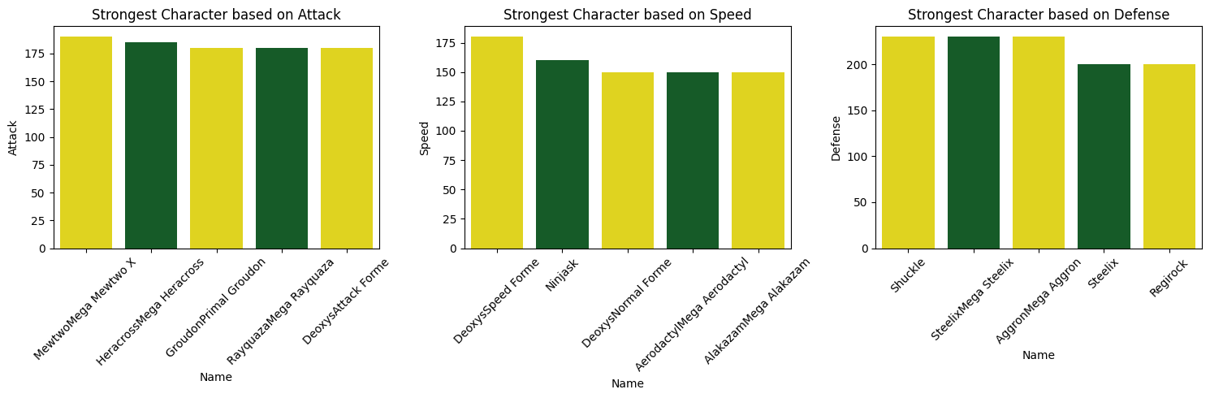

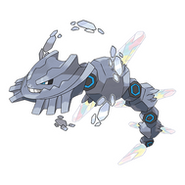
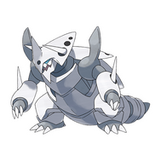
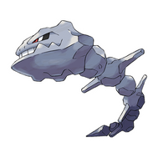
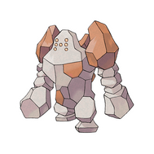

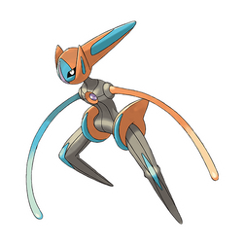

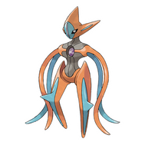

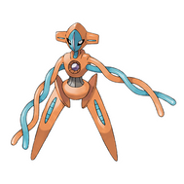
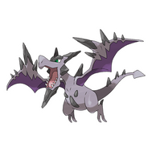


Slide 18
What types of characters do most legendary character have?

Slide 19

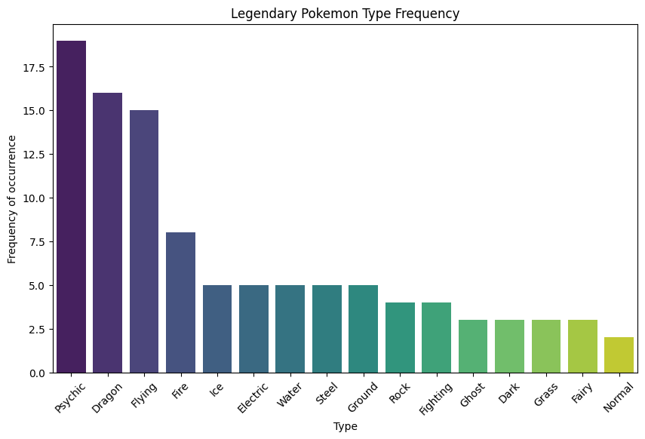
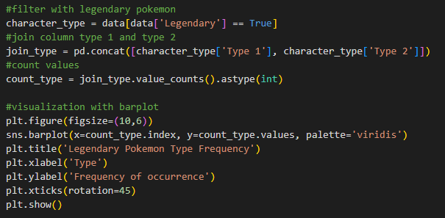

THE ANSWER IS PSYCHIC
From generation 1 to 6, the average type of legendary character is the psychic type, this type is known for attacks related to mind power, telekinesis, and other psychic abilities.

Slide 20


THANK YOU

